Slide 1

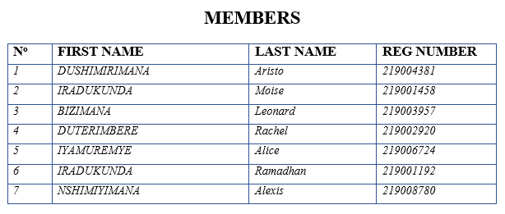
Course: E-Commerce Year of Study: Year 3 GROUP 9: Beverage Ordering system
UNIVERSITY OF RWANDA
COLLEGE OF SCIENCE AND TECHNOLOGY
SCHOOL OF INFORMATION COMMUNICATION­ TECHNOLOGY
DEPARTMENT OF COMPUTER SCIENCE

Slide 2
abstract
The aim of this research was to design the BEVERAGE ORDERING SYSTEM. It was designed because there was no mean of ordering a beverage anytime a client wants in existing system where people can order their favorite drinks anytime they want.
None can deny the effect of internet in our daily life, people would like to drink alcohol and other different drinks but they are shy to buy them at their nearest bar because they think they can be mocked. With the help of the internet we provided system that can help such kind of people to get their favorite drink easily.
It consists by taking the main information of clients’ identification. This system also was developed to achieve quality and quickly services given to the clients.

Slide 3
Introduction
Internet has become part of our life, Covid-19 promoted the use of online payment of most of services, with COVID-19 people opened their eyes to seek for other opportunity that can come along without physical access. Online Selling and Buying “Ecommerce” is among those activities that get widely spread because of COVID-19.
In our region there is no online commerce for beverage such as alcohol, so we came up with this project to introduce that easiness of internet with it effectiveness and efficiencies.

Slide 4
problem statement
There existing system uses sheet paper to store data and consumed time. Due to the limitations of this system faces a lot of problems which include:
Cause of using paper or manual work it is very difficult to find information.
Information of client can be loose.
It takes time to find record of client and other information because it is in paper.
The works are done slowly.
Long queue waiting for the drink.
Clients waste time in waiting to be served.

Slide 5
objectives
General Objective
The general objective of this website is to analyze the problems of Rwandan people face when they want to buy a beverage, so they can order any beverage after he/she login wherever they are and help the administrator to organize from the manual work from which is difficult to find the record of the client and mess bills of the client.
Specific objective
It helps to manage the manual work from which it is very difficult to find the record of the client and other information.
Facilitate transport : no need to take a fare to buy a drink because we can deliver it wherever they are.
Reduce time taken at queue.
Effectiveness and efficient services with help of internet.

Slide 6
Scope of project
In this project we will focus on the following functions services:
Creating an interface with a way in which the user can enter his/her own information form.
A way in which the client can choose a beverage according to their wish.
A way in which the client can choose a counter which is near them.
The system that can generate some information according to user.
The system that help administrator to manage or control our merchandise website
Project is limited to what I have said above.

Slide 7
Literature review
E-commerce is the activity of electronically buying or selling of products on online services or over the Internet.
E-commerce is fast gaining ground as an accepted and used business paradigm. More and more business houses are implementing web sites providing functionality for performing commercial transactions over the web. It is reasonable to say that the process of shopping on the web is becoming commonplace.
Beverage Ordering system is System that is originally placed at University of Rwanda developed by Student of Year 3 Computer Science to reduce time taken by people to get their favorite drink, to provide drinks to those who are shy to buy drinks and those who don’t want to be known because we keep users information with highly confidential.

Slide 8
Literature review… ctd
HTML (Hyper Text Markup Languages) is used to create a document on the World Wide Web (www). It is simply a collection of certain keywords called “tags” that is helpful in writing document to be displayed using a browser on internet.
CSS
What is CSS?
CSS stands for Cascading Style Sheets
Styles define how to display HTML elements
Styles are normally stored in Style Sheets..
PHP
Hypertext pre-processor is a widely-used general purposed scripting language that is especially suited for web development and can be embedded into hypertext mark-up language (HTML) pages that are then saved with a PHP file extension.
It run using XAMPP server.

Slide 9
techniques used to collect data
Observation method:
Observation is visual study of something or someone in order to gain information.
Interview techniques
An interview is a technique used when we have made observation to collect a variety of information from Academic and finance departments related to student registration from the beginning up to the end of registration.
Documentary techniques
It is another technique used to collect data, and we usually know that for getting the facts information we must read the books and visiting the internet web sites in order to do effective and efficiency research.

Slide 10
expected results
Web application that will help clients and Company’s finance office manage bills easily,
Easy of clients to order a beverage whenever they are.
Most reliable security of data and bills.
Requirements:
Software required
Operating system: Microsoft Windows7, etc.…
Browser : Mozilla Firefox, Internet explorer, Netscape Navigator, etc.
Web server: XAMPP
Language: Php
Database package: MySQL
Front End tools: HTML, CSS, JavaScript…
Hardware required
CPU: Pentium III processor or Higher processor
RAM: 125 MB or plus
HDD: 20 GB
Keyboard, Monitor, Mouse, Printer

Slide 11
Description of existing system
In the existing system, there are still much paper work, use of long time… that means it is a little bit traditionally. Even though there are those facts, the existing system has the advantages and disadvantages:
Disadvantages
They are listed in chapter 1 in the problem statements.
Advantages
Many people are still down on technology, then they can also use the system as it doesn’t require much knowledge.
The system helps the citizens to come up with their own way of selling their homemade products.

Slide 12
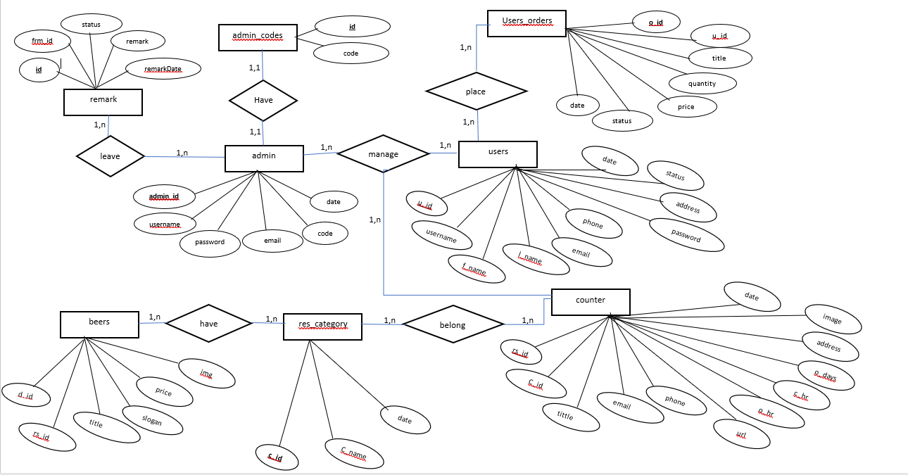
ENTITY RELATIONSHIP DIAGRAM of new system

Slide 13
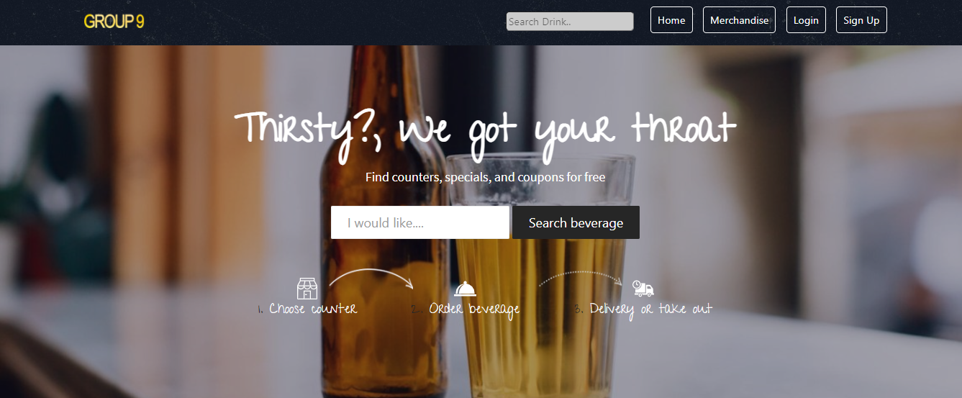
NEW SYSTEM user’s side
Index page

Slide 14
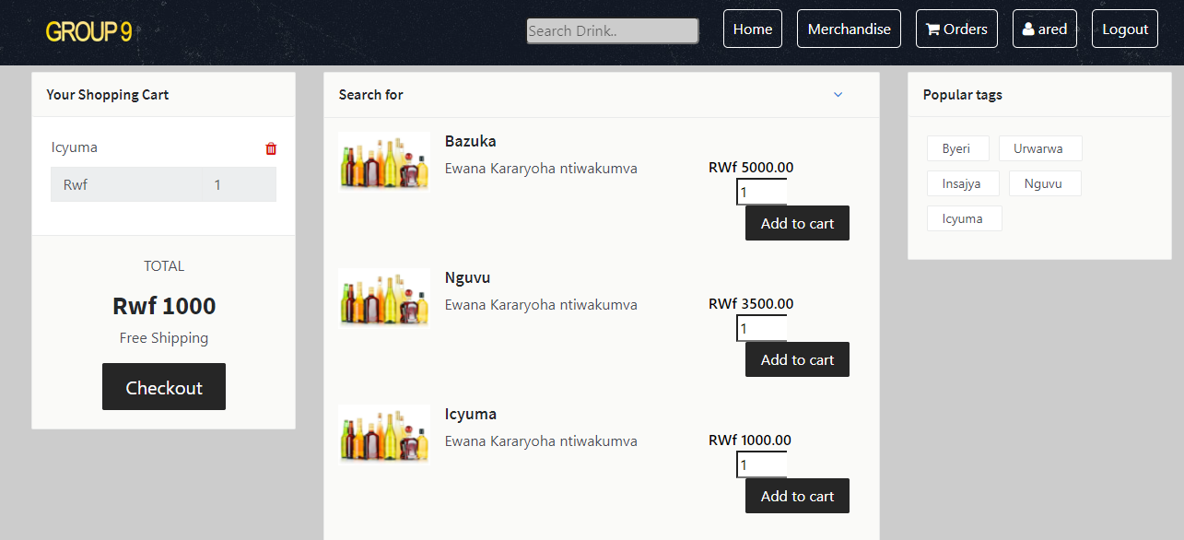
NEW SYSTEM…. ctd user’s side
Product list and add to cart page

Slide 15
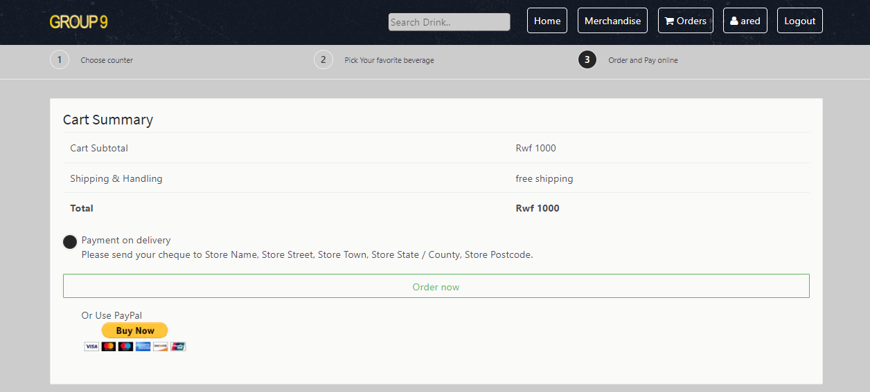
NEW SYSTEM… ctd user’s side
Checkout page

Slide 16
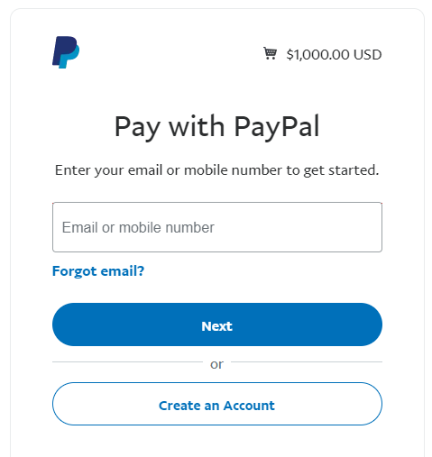
NEW SYSTEM…. ctd user’s side
Payment via PayPal page

Slide 17
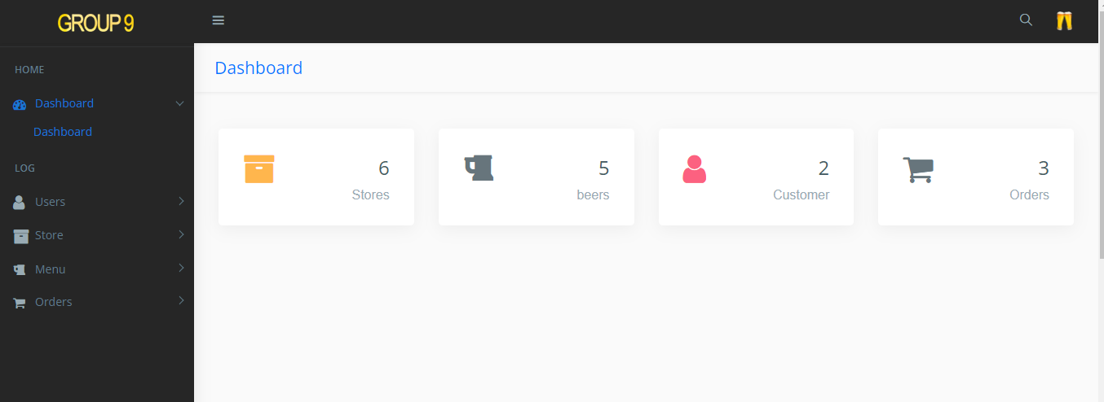
NEW SYSTEM…. ctd Administrator side
Monitoring Page

Slide 18
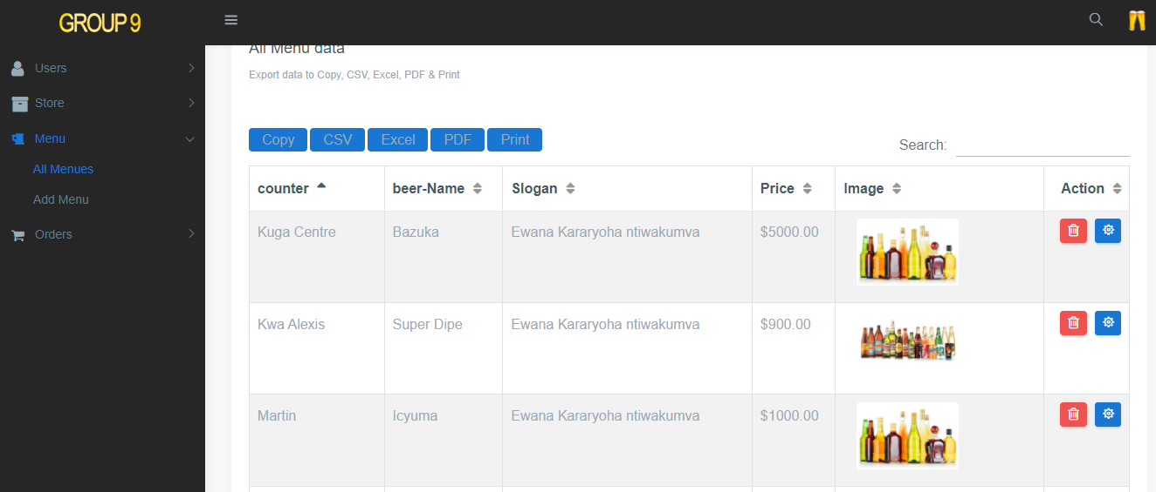
NEW SYSTEM…. ctd Administrator side
All menu data

Slide 19
Conclusion and recommendation
Conclusion
During the realization of my project I used all possible solution to analyze a system that will facilitate all Rwandan people to order beverage online without spending a long time. According to the hypothesis, our implementation was successfully.
Recommendation
During this work, we have met many problems this is the reason why we recommend to our school authorities,
To provide all needed material, books and other documents (such as computers) and to give permission to the computer to bring their materials and also to give them enough time in laboratory.
To provide a precise time for supervisor to meet with the students and, I would also recommend the students to work hard or time during the project.

Slide 20
References and bibliography
Books and Publications
1. Team Lib (the delta guide to offer free books for java, PHP, Mysql, and Apache)
2. The website www.phpmyadmin.org it helped us to download 21 video teaching the basic knowledge to Apache and Mysql.
3. www.w3.org teaching the platform for CSS, HTML, and will help us to connect the traffic of data online
4. Simsion, Graeme, data Modeling Essentials, Analysis, Design, and innovation international Thompson Computer press, 1983.
References
https://en.wikipedia.org/wiki/E-commerce
https://www.php.net/
https://www.mysql.com/
https://www.apachefriends.org/
https://www.mozilla.org/en-US/firefox/new/
www.w3schools.com/htm/html
https://www.w3schools.com/css/

Slide 21
END..
Questions and suggestions will be highly appreciated
THANK YOU!!!!!!!!!!!!!

